Slide 1
Unit-3
Component Level Design
Types of Cohesion
Presented By Dr.R.Kavitha,SoC
SASTRA University

Slide 2
What is Cohesion in Sw Engg?
Cohesion is a measure of the degree to which the elements of the module are functionally related. It is the degree to which all elements directed towards performing a single task are contained in the component. Basically, cohesion is the internal glue that keeps the module together. A good software design will have high cohesion. (family of modules)

Slide 3

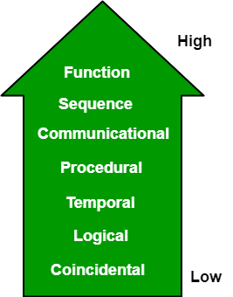
Hierarchical view of
SW cohesion types

Slide 4
Functional Cohesion
Functional Cohesion: Every essential element for a single computation is contained in the component. A functional cohesion performs the task and functions. It is an ideal situation.
Calculate Total amount of transactionID

Slide 5
Sequential Cohesion
Sequential Cohesion : An element outputs some data that becomes the input for other element, i.e., data flow between the parts. It occurs naturally in functional programming languages.
From stock to delivery
Purchase()->stock()->sell()->deliver()

Slide 6
Communicational Cohesion
Communicational Cohesion: Two elements operate on the same input data or contribute towards the same output data. Example- update record in the database and send it to the printer.

Slide 7
Procedural Cohesion
Procedural Cohesion: Elements of procedural cohesion ensure the order of execution. Actions are still weakly connected and unlikely to be reusable. Ex- calculate student GPA, print student record, calculate cumulative GPA, print cumulative GPA.

Slide 8
Temporal Cohesion
Temporal Cohesion: The elements are related by their timing involved. A module connected with temporal cohesion all the tasks must be executed in the same time span. This cohesion contains the code for initializing all the parts of the system. Lots of different activities occur, all at unit time.
CheckOTP()

Slide 9
Logical Cohesion
Logical Cohesion: The elements are logically related and not functionally. Ex- A component reads inputs from tape, disk, and network. All the code for these functions is in the same component. Operations are related, but the functions are significantly different.

Slide 10
Coincidental Cohesion
Coincidental Cohesion: The elements are not related(unrelated). The elements have no conceptual relationship other than location in source code. It is accidental and the worst form of cohesion. Ex- print next line and reverse the characters of a string in a single component.

Slide 11
Informational Cohesion
Informational Cohesion: Informational cohesion occurs when elements or tasks are grouped together in a module based on their relationship to a specific data structure or object, such as a module that operates on a specific data type or object. Informational cohesion is commonly used in object-oriented programming.
Ex. LinkedList, BlockChain

Slide 12
Functional Cohesion
Functional Cohesion: This type of cohesion occurs when all elements or tasks in a module contribute to a single well-defined function or purpose, and there is little or no coupling between the elements. Functional cohesion is considered the most desirable type of cohesion as it leads to more maintainable and reusable code.

Slide 13
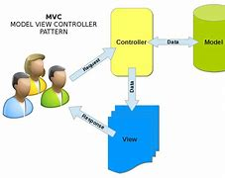
Layer Cohesion
Layer Cohesion: Layer cohesion occurs when elements or tasks in a module are grouped together based on their level of abstraction or responsibility, such as a module that handles only low-level hardware interactions or a module that handles only high-level business logic. Layer cohesion is commonly used in large-scale software systems to organize code into manageable layers. Ex. User view/DB

Slide 14
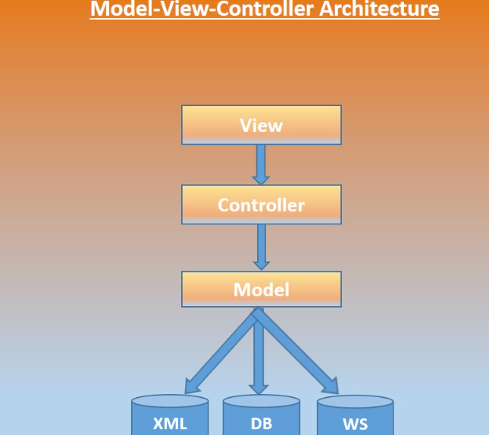

Slide 15
THANK YOU

